Slide 1
Web scraping BOT to buy products online
By Aayush Jain

Slide 2
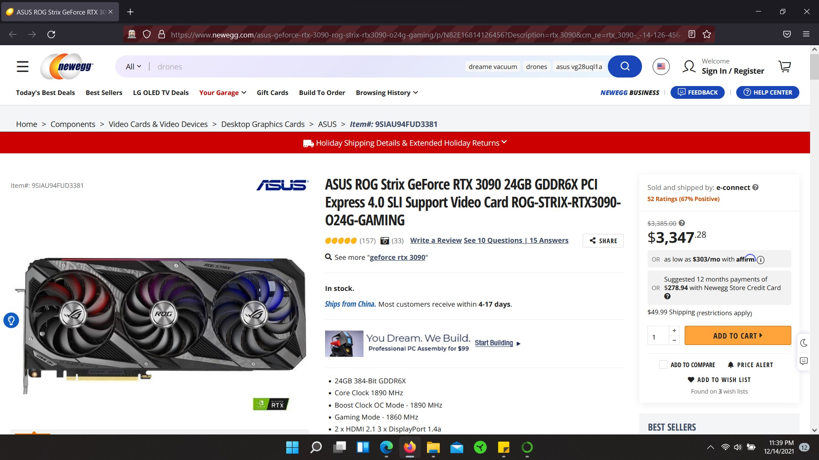

Slide 3
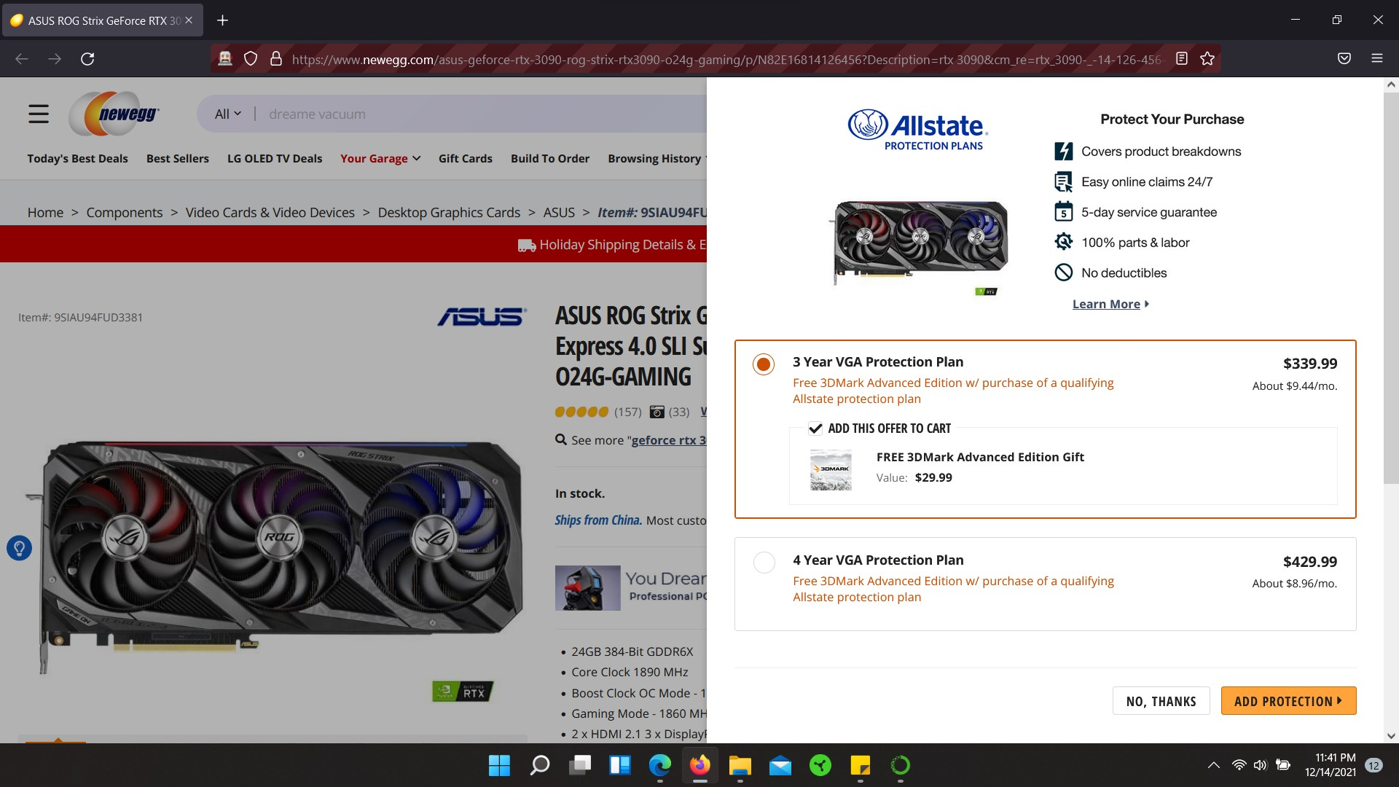

Slide 4
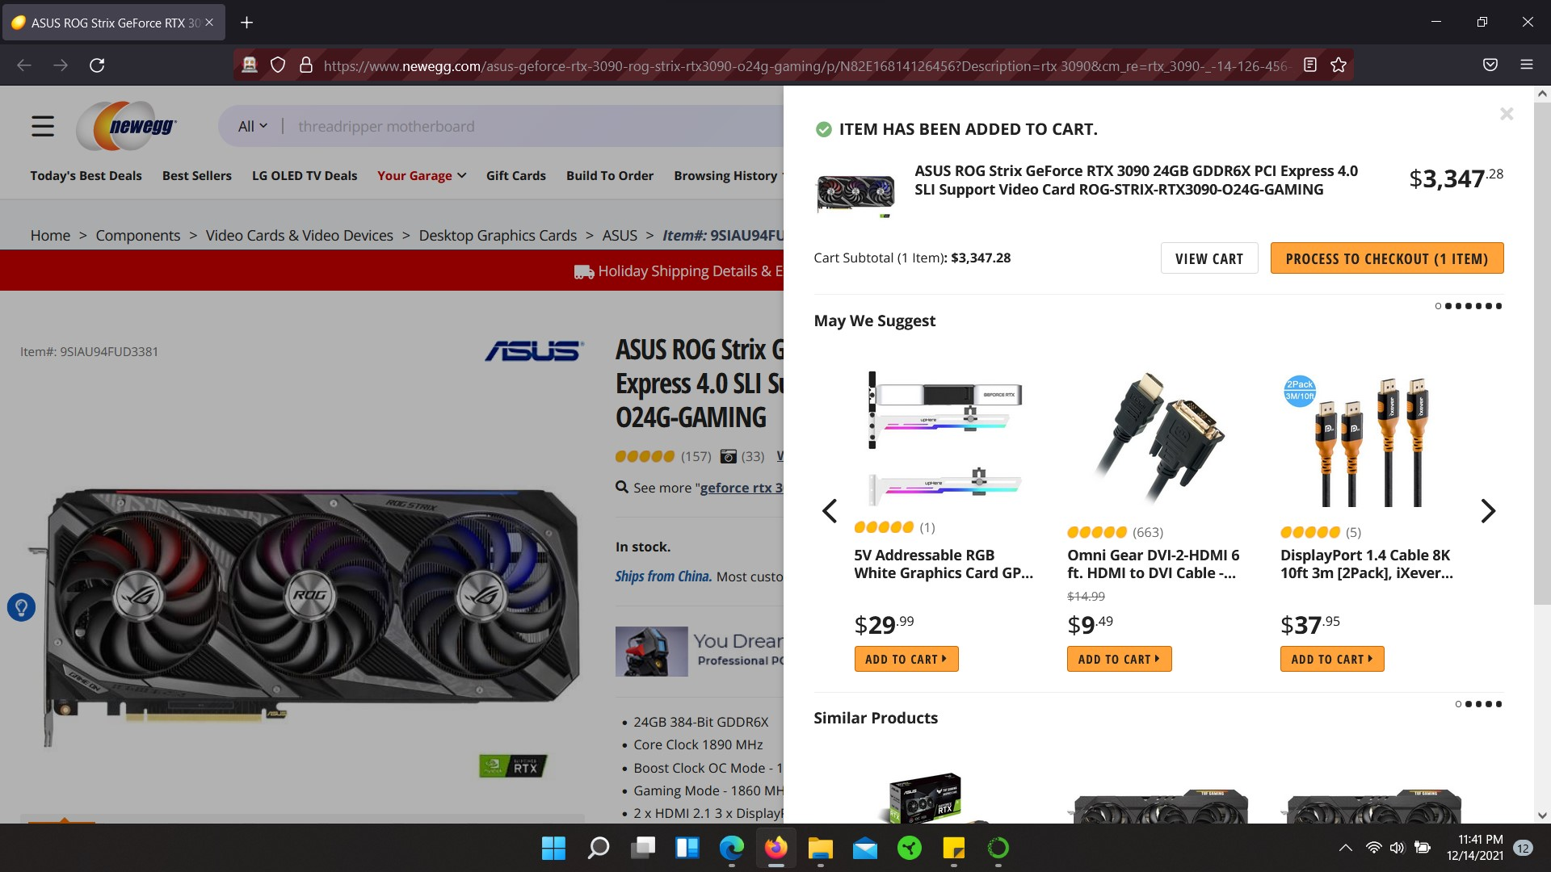

Slide 5
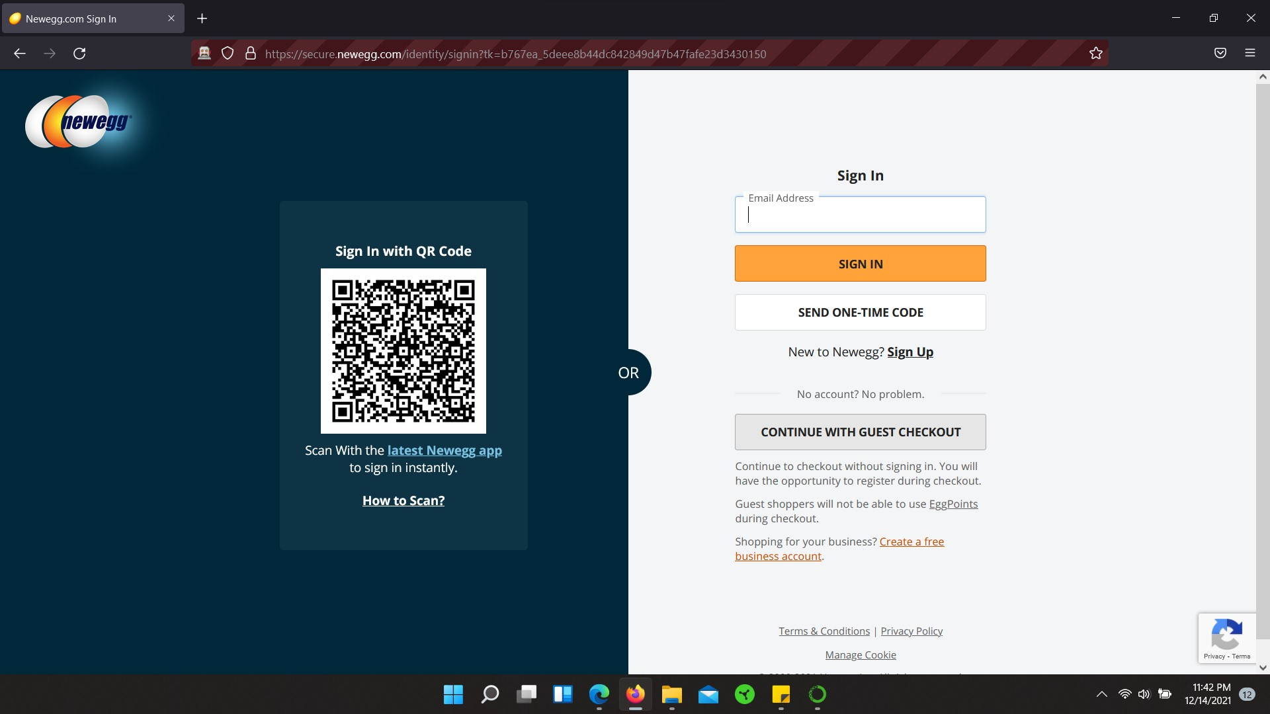

Slide 6
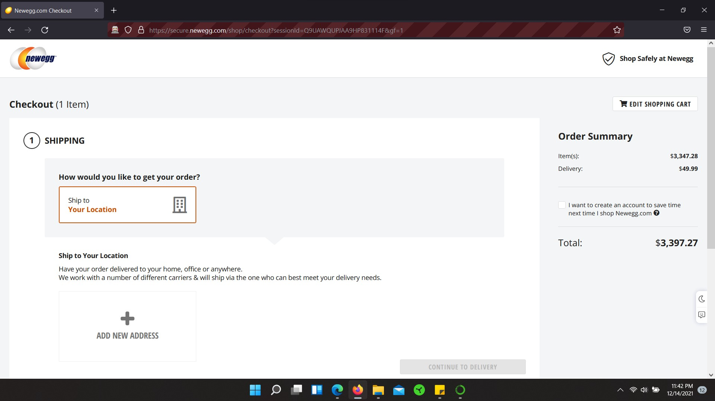

Slide 7
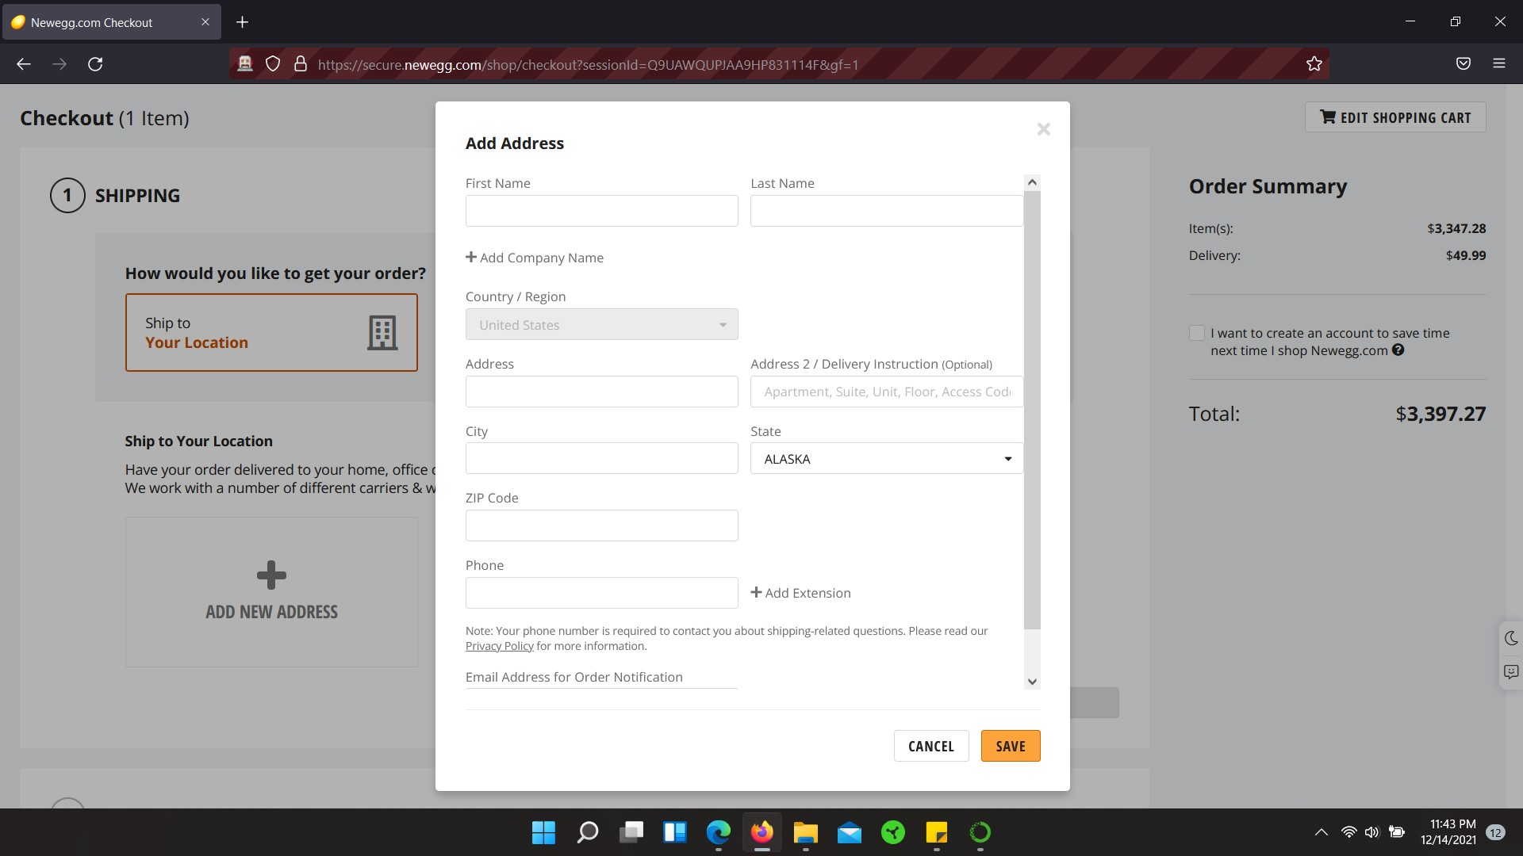

Slide 8
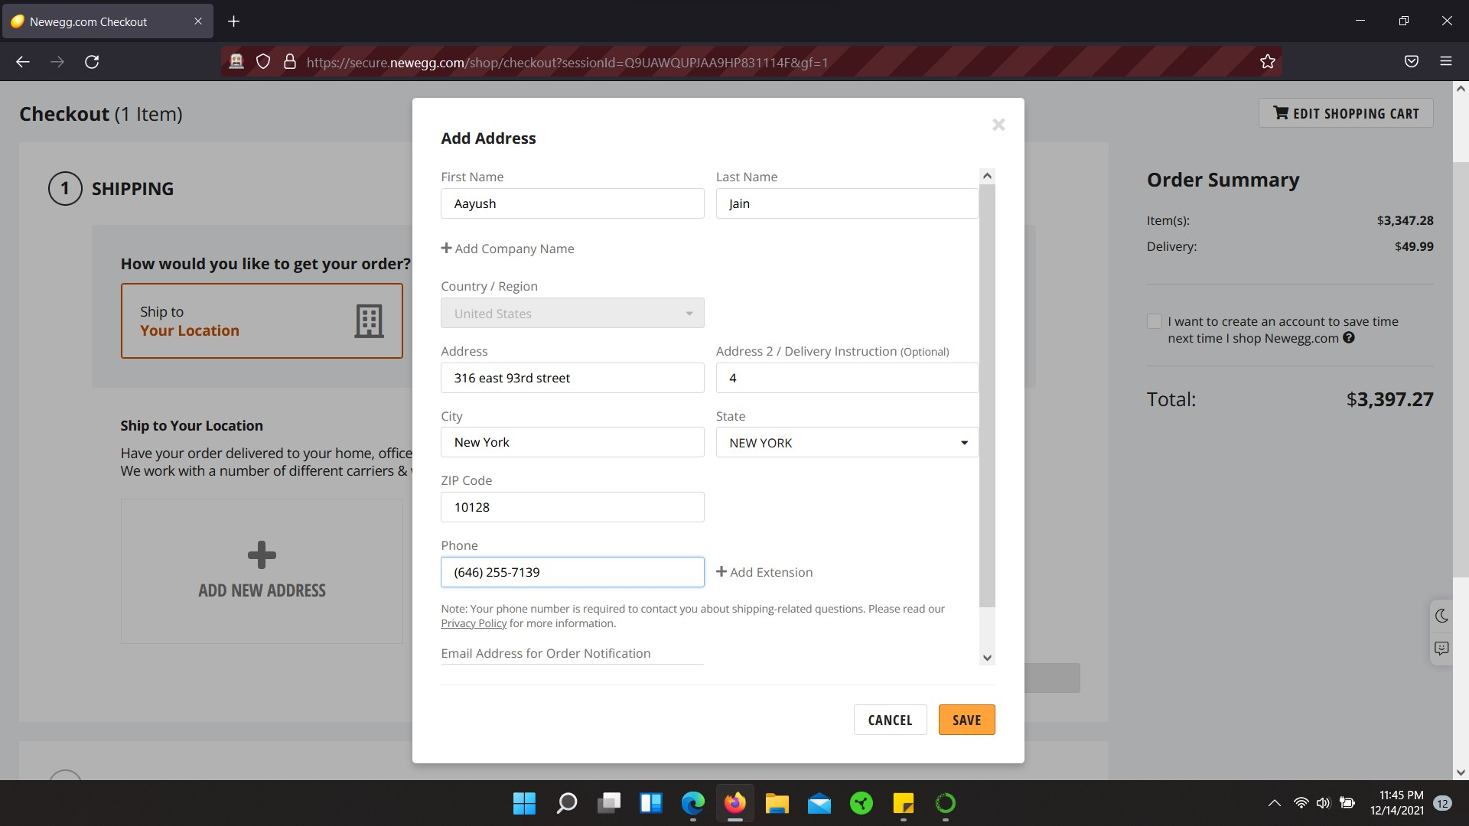

Slide 9
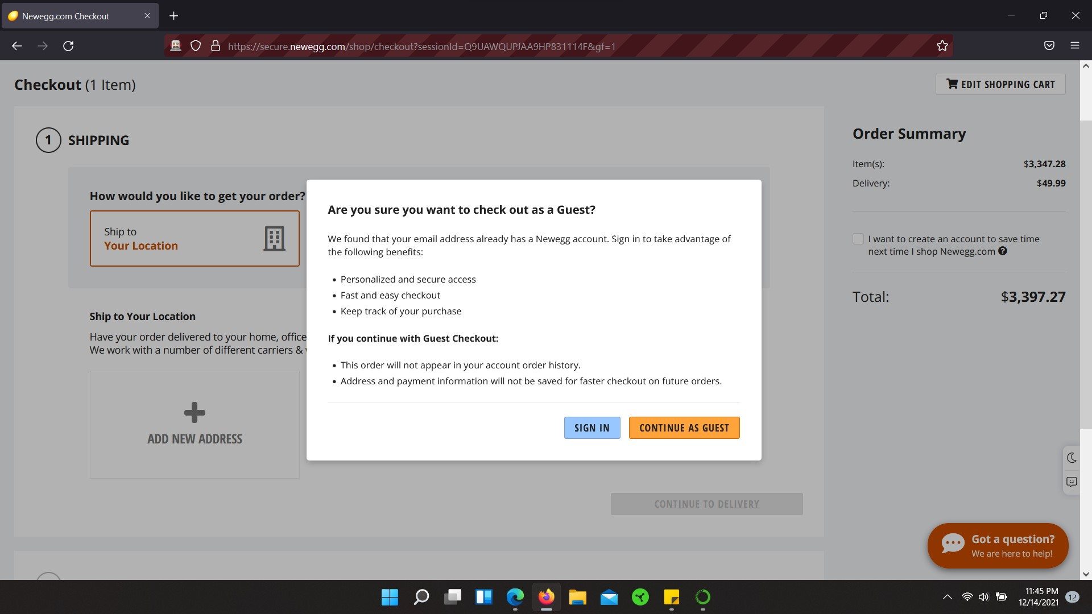

Slide 10
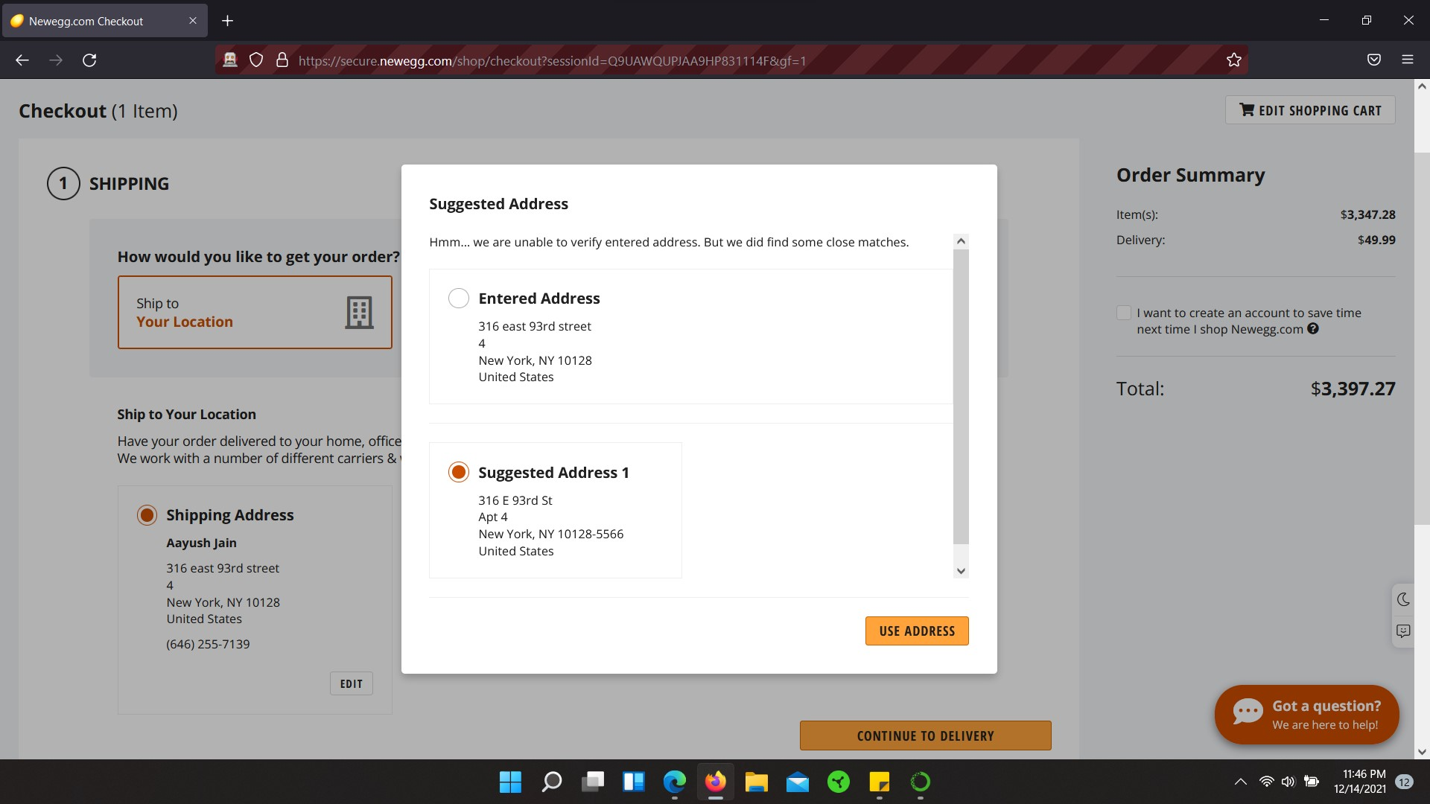

Slide 11
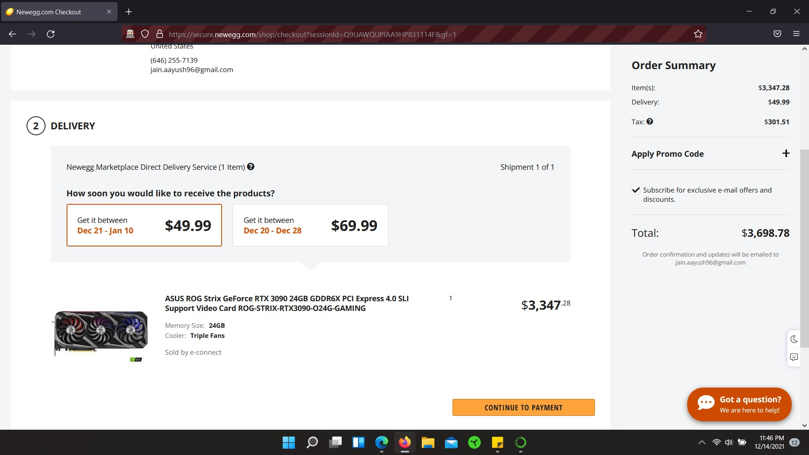

Slide 12
Questions
Feel free to reach out if you want that one thing you are looking for but always ends up out of stock!
If you can’t beat them JOIN them (Scalpers)

Slide 13
Thank-you

